Slide 1
The Coding Bootcamp: Day 0

Slide 2
Before We Begin...
Just a few notes about Zoom before we begin...

Slide 3
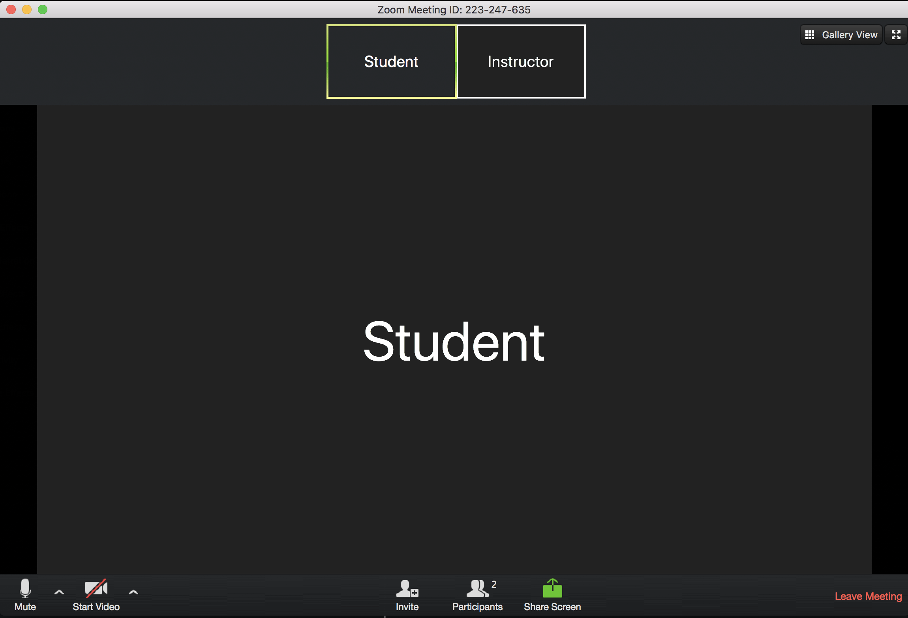
User Controls are located at the bottom of your Zoom

Slide 4
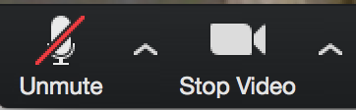
Microphone and Camera Settings
Mute yourself unless you’re speaking
Leave video on during class so the instructor can see you!
Notes:
Have students mute themselves and their videos on!

Slide 5
Participant Window & Raise Hand
Click “Participants” button to open menu, you’ll see a “Raise Hand” button here
You can also “Lower Hand” after raising in this menu
Notes:
Have students all raise their hands then lower them!

Slide 6
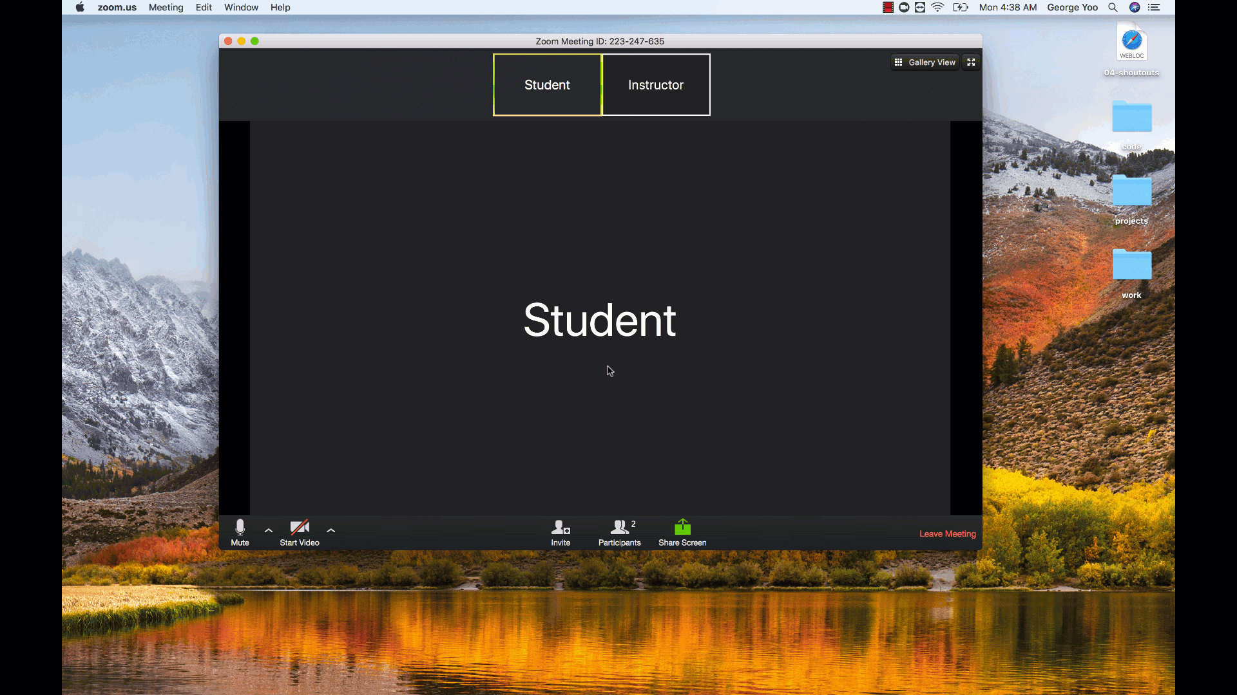
Participant Window & Raise Hand

Slide 7

Let’s Begin!
Now that we have that out of the way...
On with the show!

Slide 8

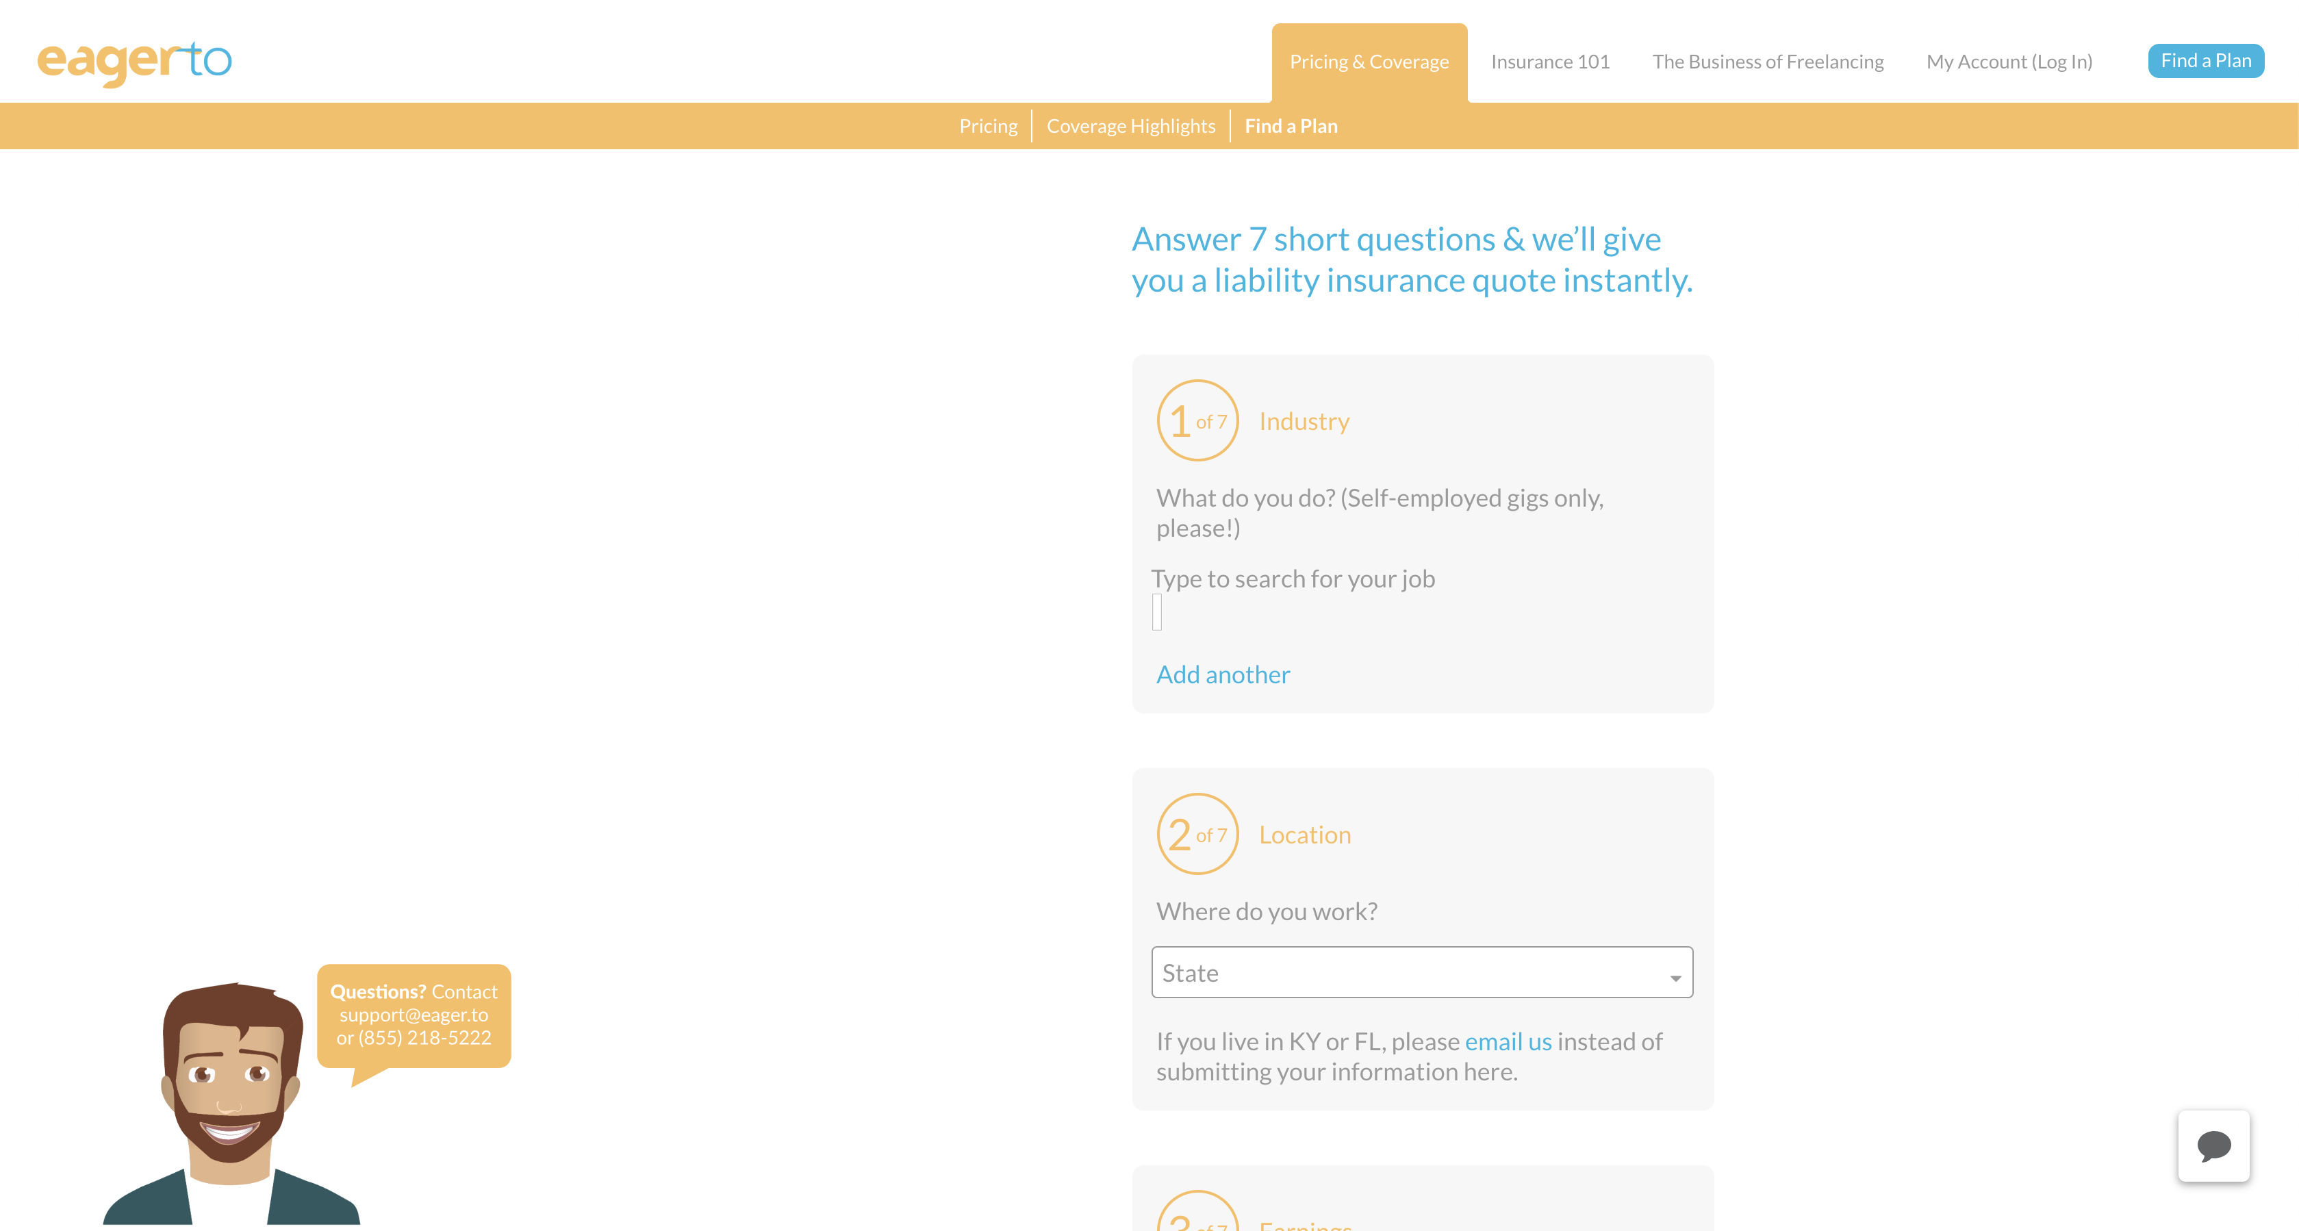
Some Cool Stuff I Made...

Slide 9
Online Class Schedule

Slide 10
Online Class
Weekday
Office Hours: 5:45pm - 6:30pm
Class: 6:30pm - 9:30pm
Office Hours: 9:30pm - 10pm

Slide 11
Online Class
Weekend
Office Hours: 9:15am - 10:00am
Class: 10:00am - 2:00pm
Office Hours: 2:00pm - 2:30pm

Slide 12
Online Class
Office hours and class will be hosted on Zoom!

Slide 13
Tools for Fools

Slide 14
Online Class
Slack
Zoom
Visual Studio Code

Slide 15
Slack Desktop Client

Slide 16
Slack Desktop Client
Everyone take a moment to download the Slack Desktop App if you haven’t already!
https://slack.com/downloads/

Slide 17
Slack

Slide 18
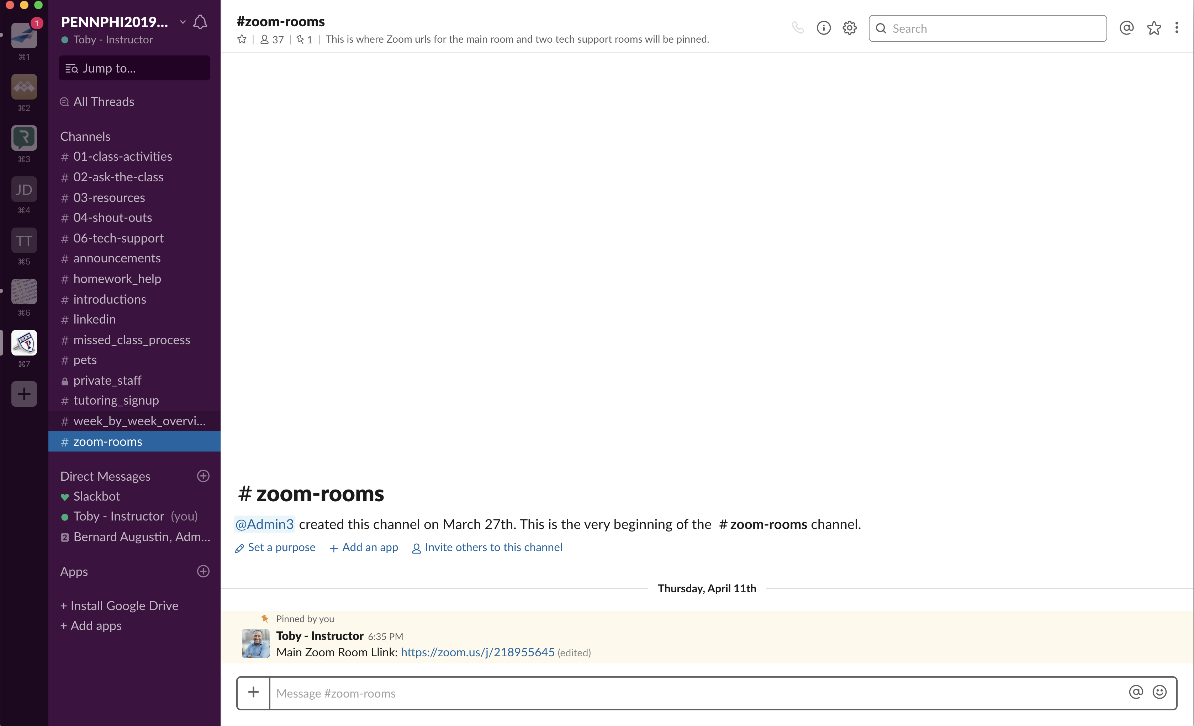
Slack Channels
#zoom-rooms

Slide 19
#01-zoom-rooms
Links for Online Class:
Main Room

Slide 20
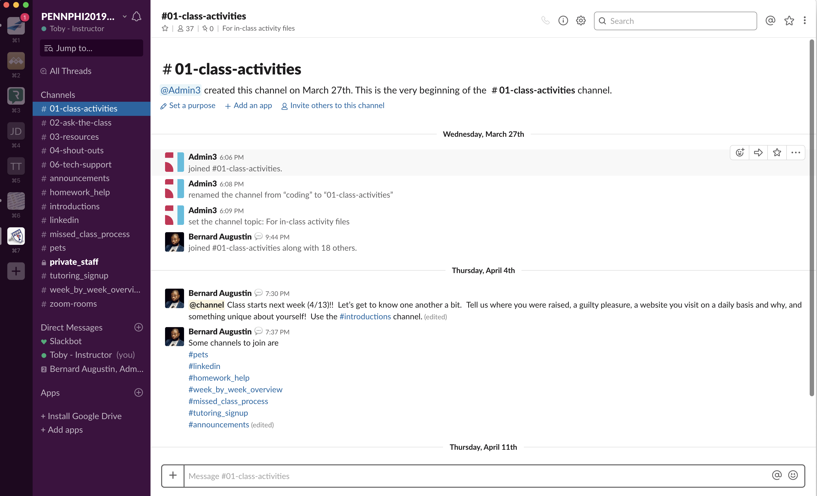
Slack Channels
#01-class-activities

Slide 21
#02-class-activities
Activity files you’ll work on during class will be posted in #01-class-activities.

Slide 22
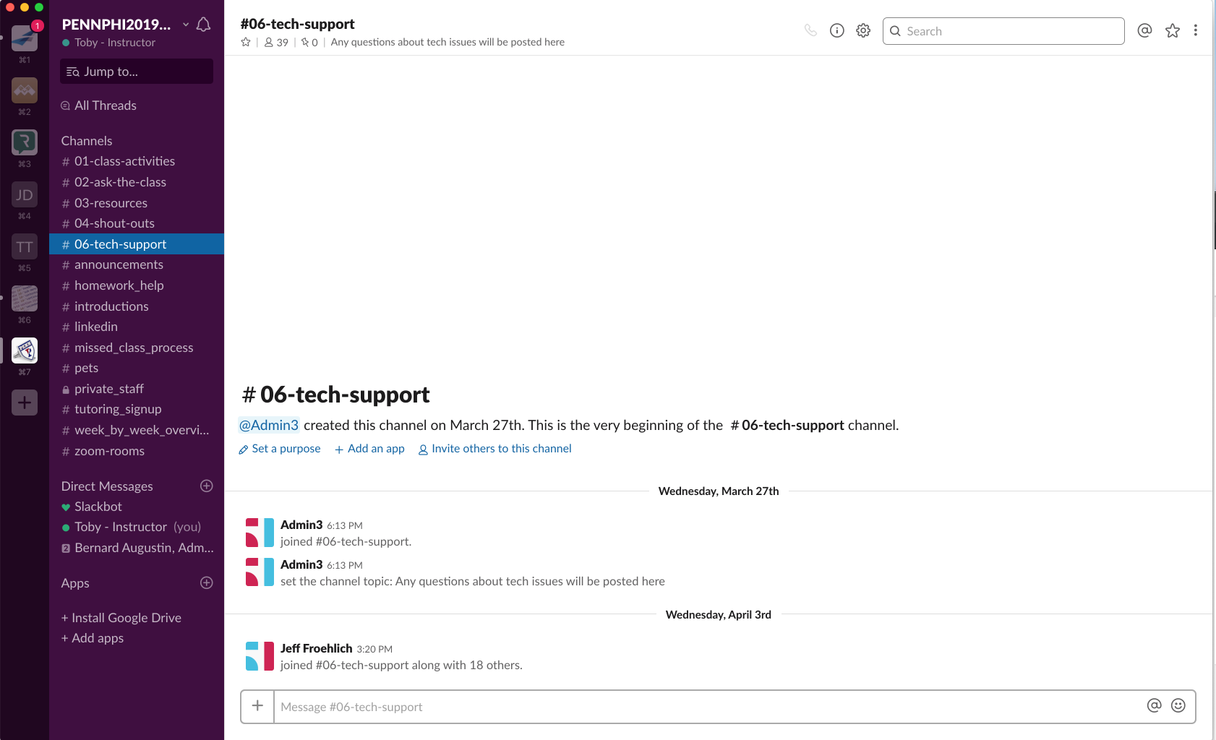
Slack Channels
#06-tech-support

Slide 23
#03-tech-support
Technical difficulties? Post in #06-tech-support!
Your instructional staff & classmates can help.

Slide 24
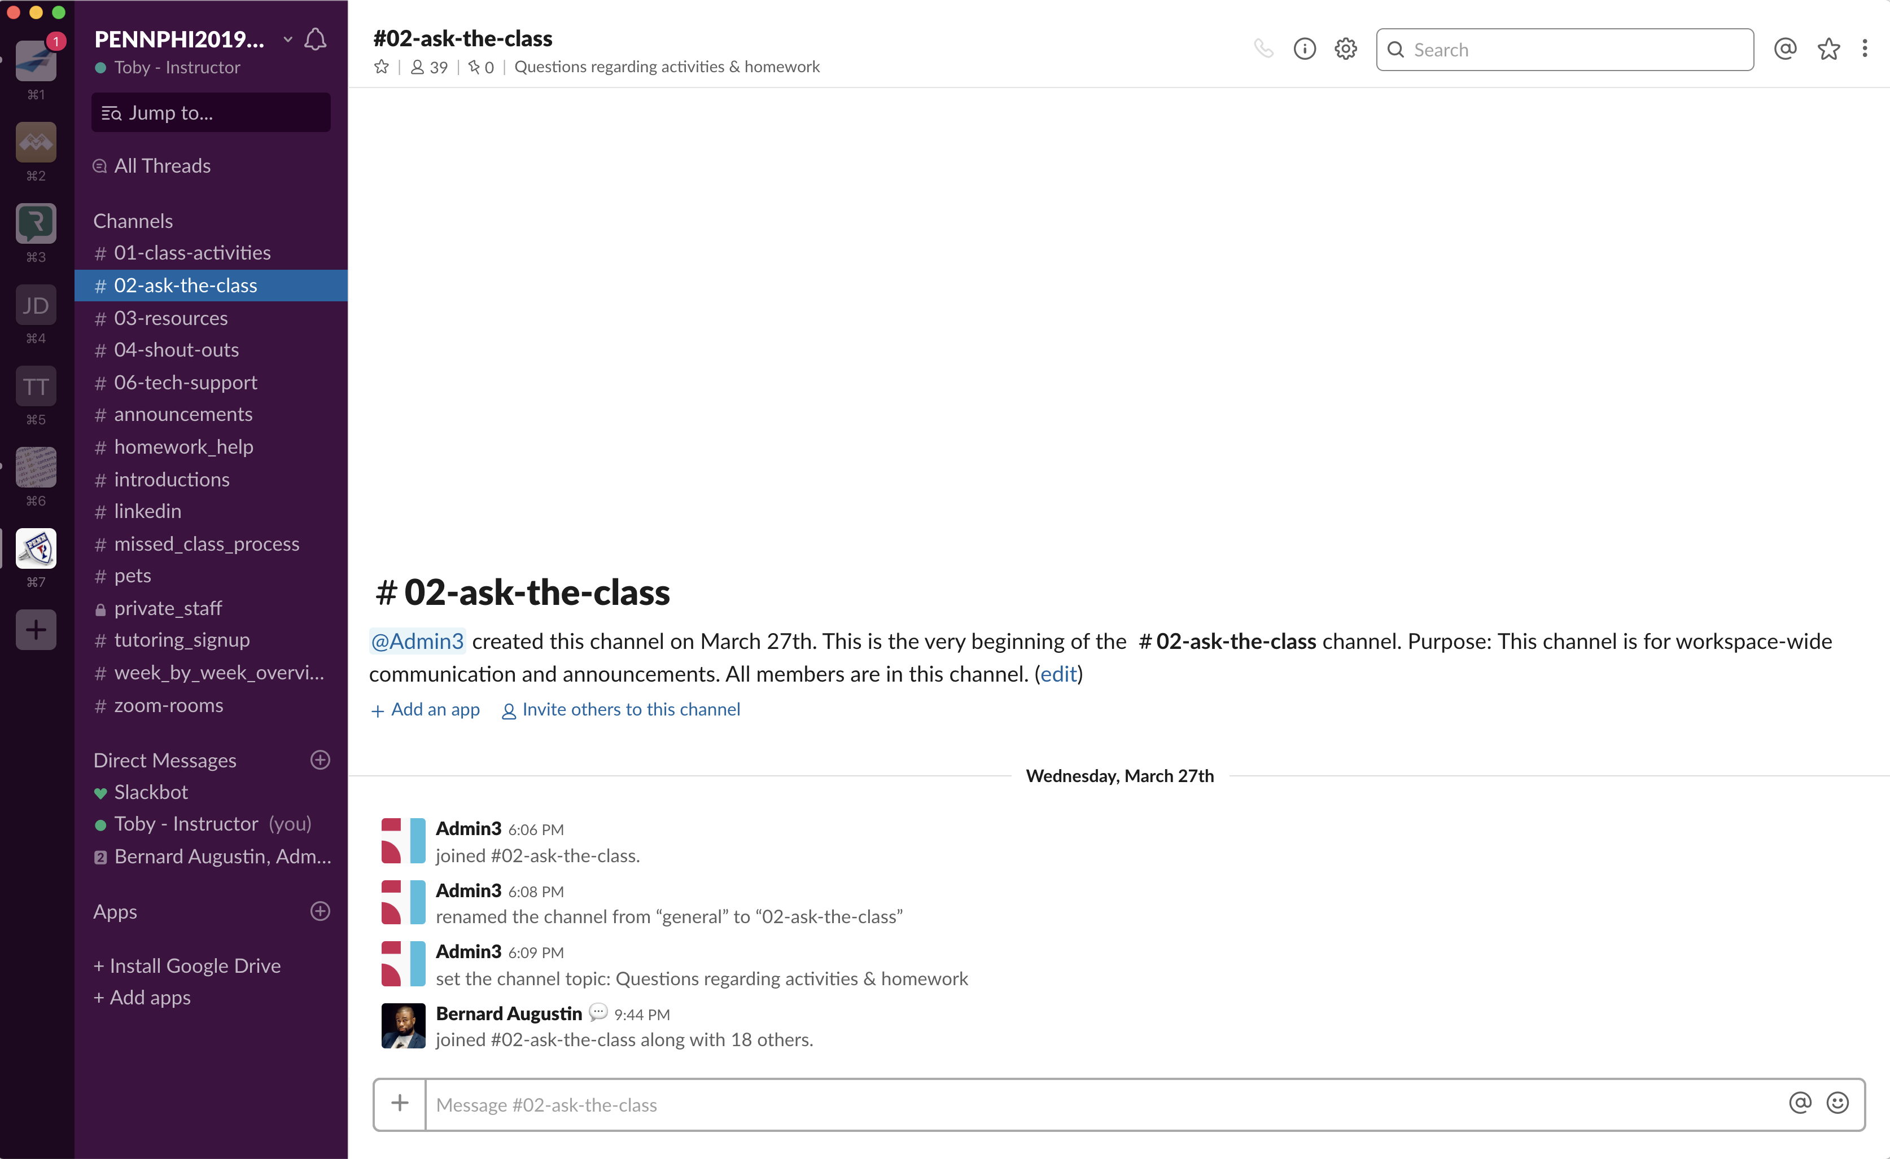
Slack Channels
#02-ask-the-class

Slide 25
#04-ask-the-class
Post questions about activities, homework, and projects in #02-ask-the-class.
Your instructional staff & classmates can help.

Slide 26
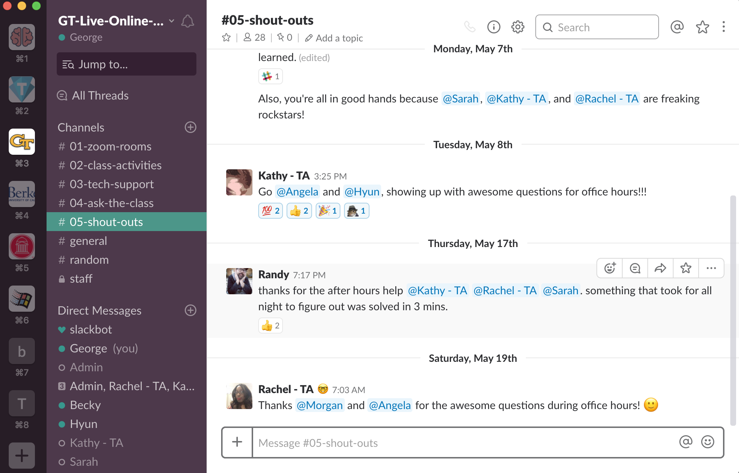
Slack Channels
#04-shout-outs

Slide 27
#05-shout-outs
Does someone deserve a virtual high five?
Post it in #04-shout-outs so we can celebrate each other.

Slide 28
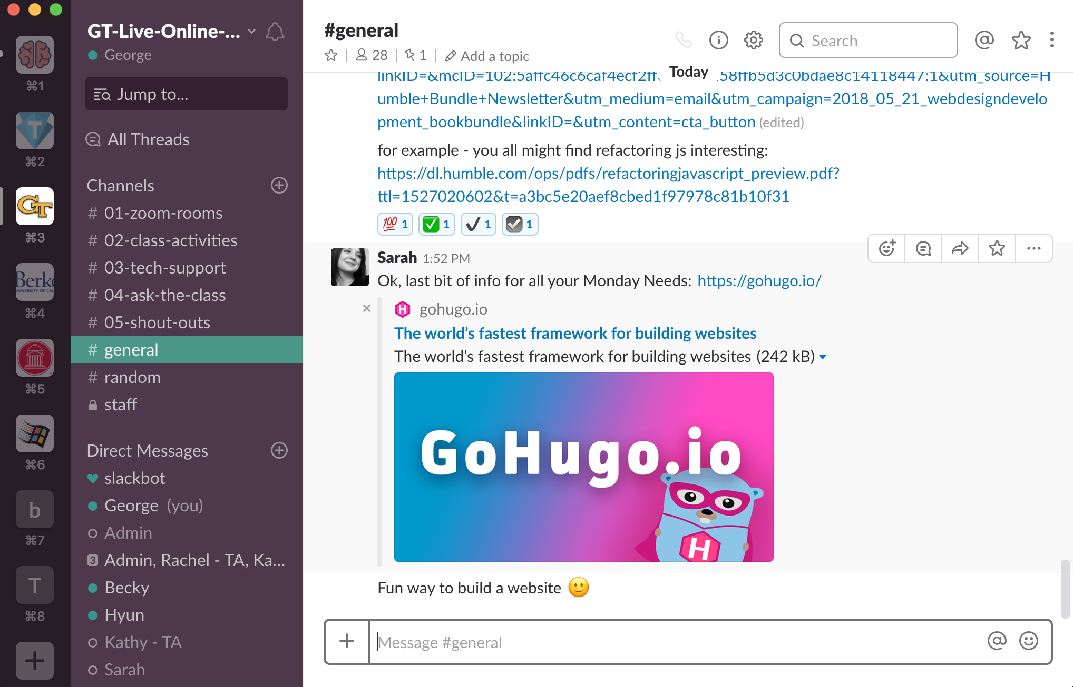
Slack Channels
#announcements

Slide 29
#general
General class announcements are posted in #announcements.

Slide 30
Last, but not least...
Add your real name, and picture to Slack, it will help everyone start memorizing each other’s names and faces!
Notes:
Take a few minutes to allow students to update their slack profiles!

Slide 31
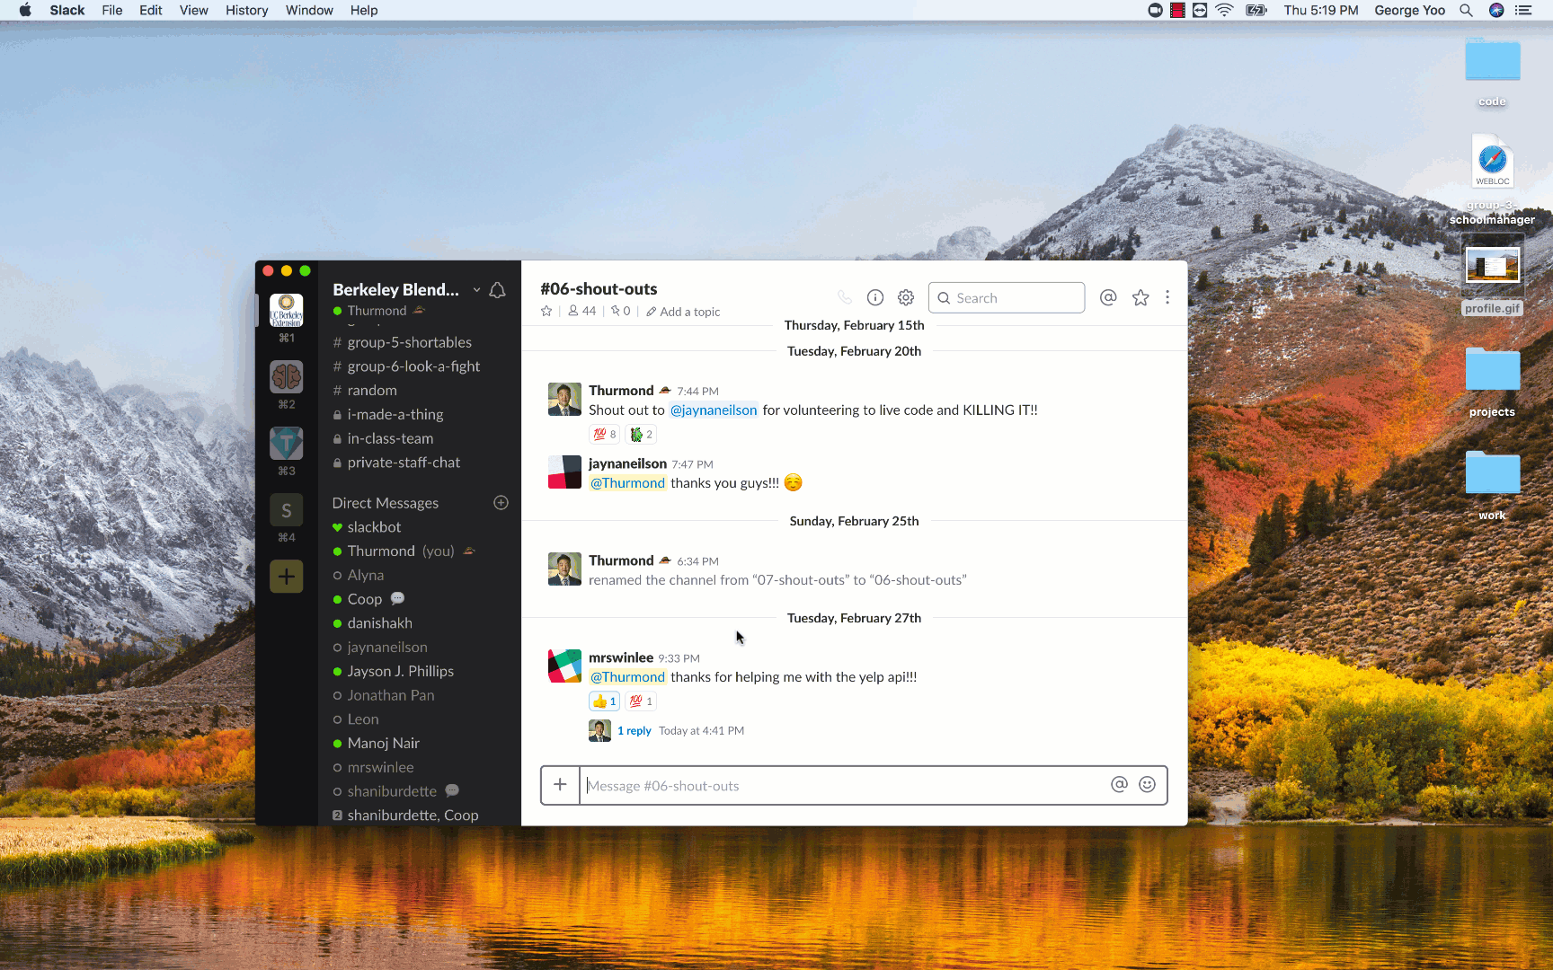
Slack Profile

Slide 32
Zoom

Slide 33
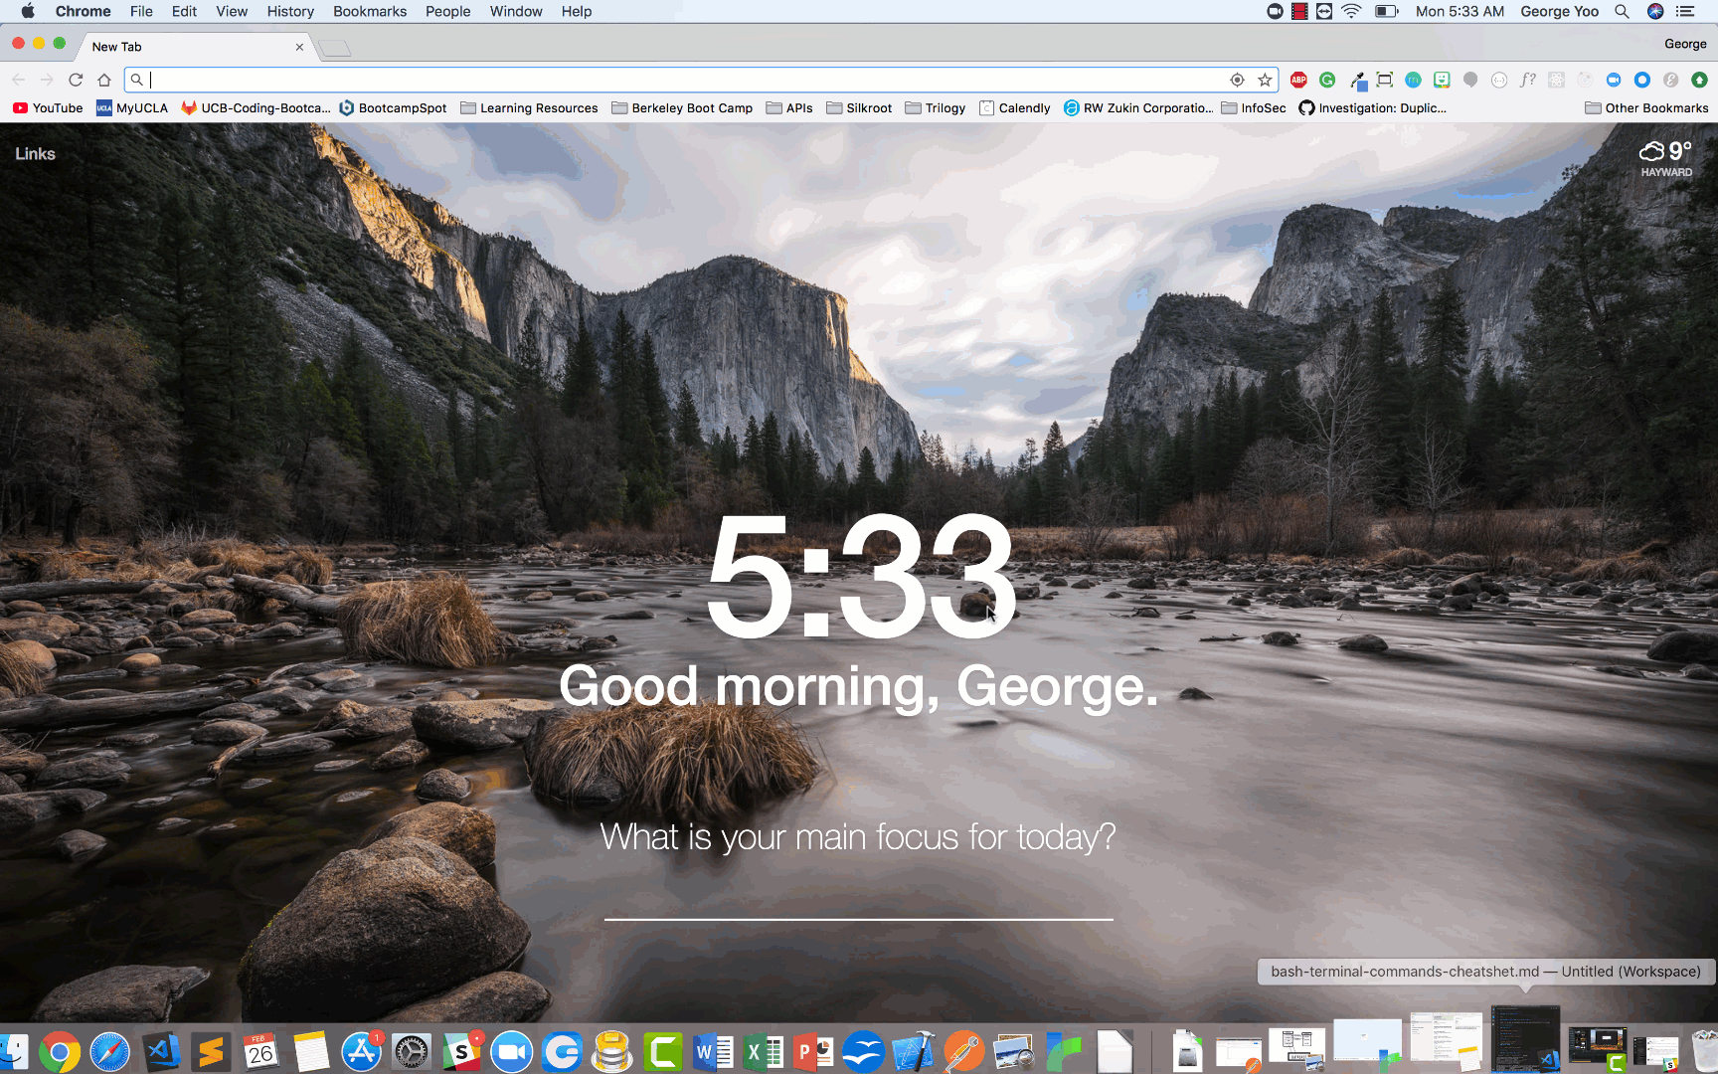
Sign up for a personal Zoom account at Zoom.us

Slide 34
Sign up for a personal Zoom account at Zoom.us
You can use your personal ID to meet with classmates outside of class hours (40 min max)

Slide 35
Zoom Client Settings

Slide 36
Zoom Client Settings
Make sure you’re logged into your new zoom account!
Next, click “Zoom -> Preferences”

Slide 37
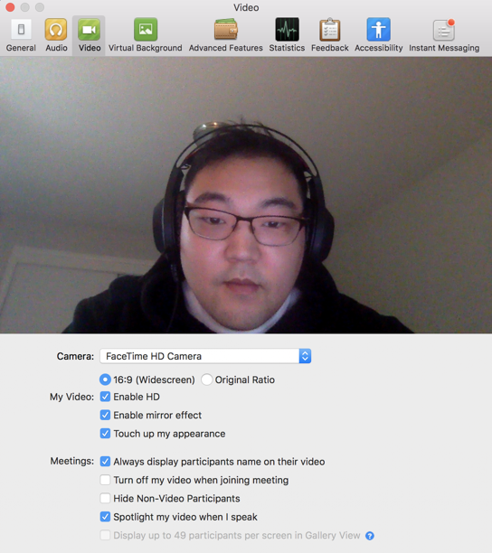
Zoom Client Settings
Video tab: Check "Always display participants name on their video"

Slide 38
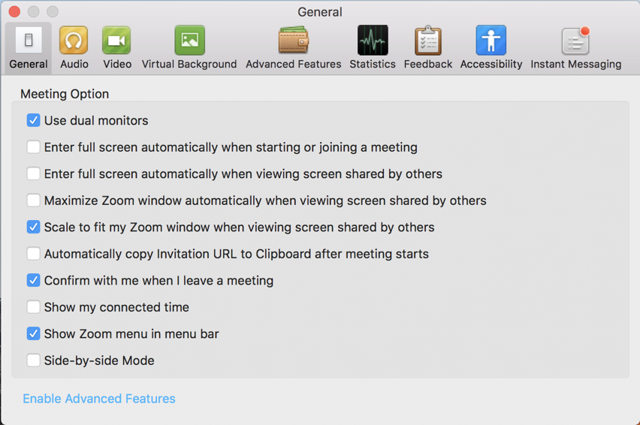
Zoom Client Settings
General:
- Check "Use Dual Monitors" and
- Uncheck “Full screen auto upon entering meeting”

Slide 39
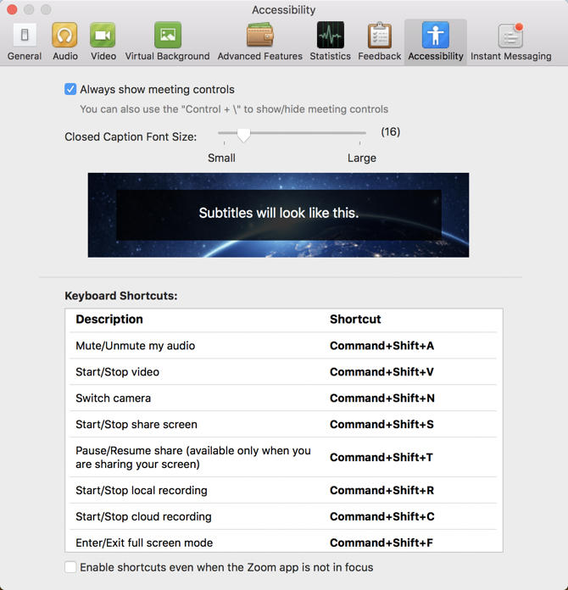
Zoom Client Settings
Accessibility: Check “Always show meeting controls”

Slide 40
Features

Slide 41
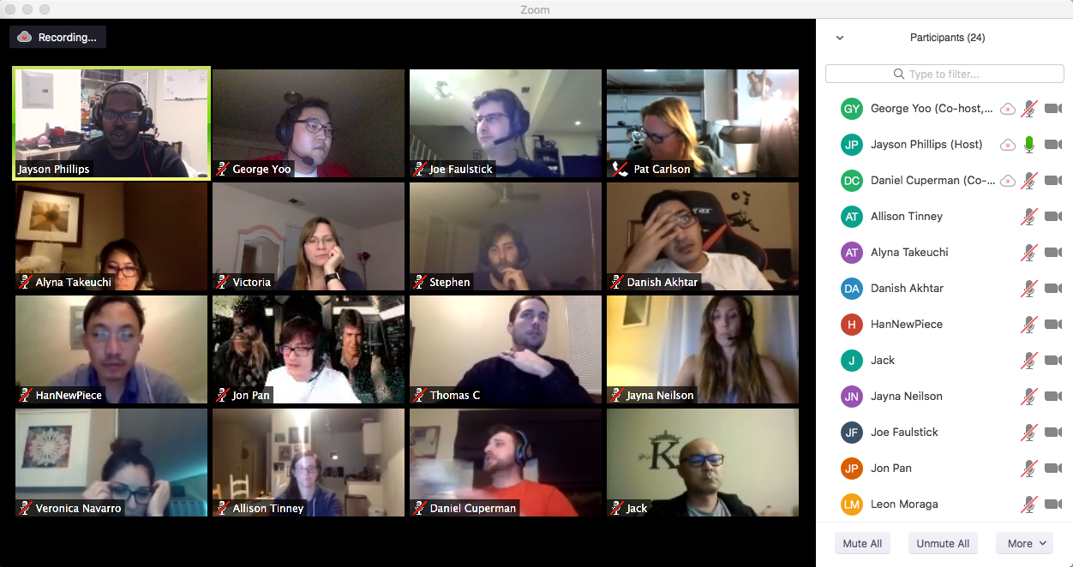
Use Gallery View to see all your classmates!
Notes:
The “Gallery” and “Speaker” views toggle button is located at the top right of the Zoom screen.

Slide 42
Use Gallery View to see all your classmates!
Try it! Switch between “Speaker View” and “Gallery View” on Zoom!

Slide 43
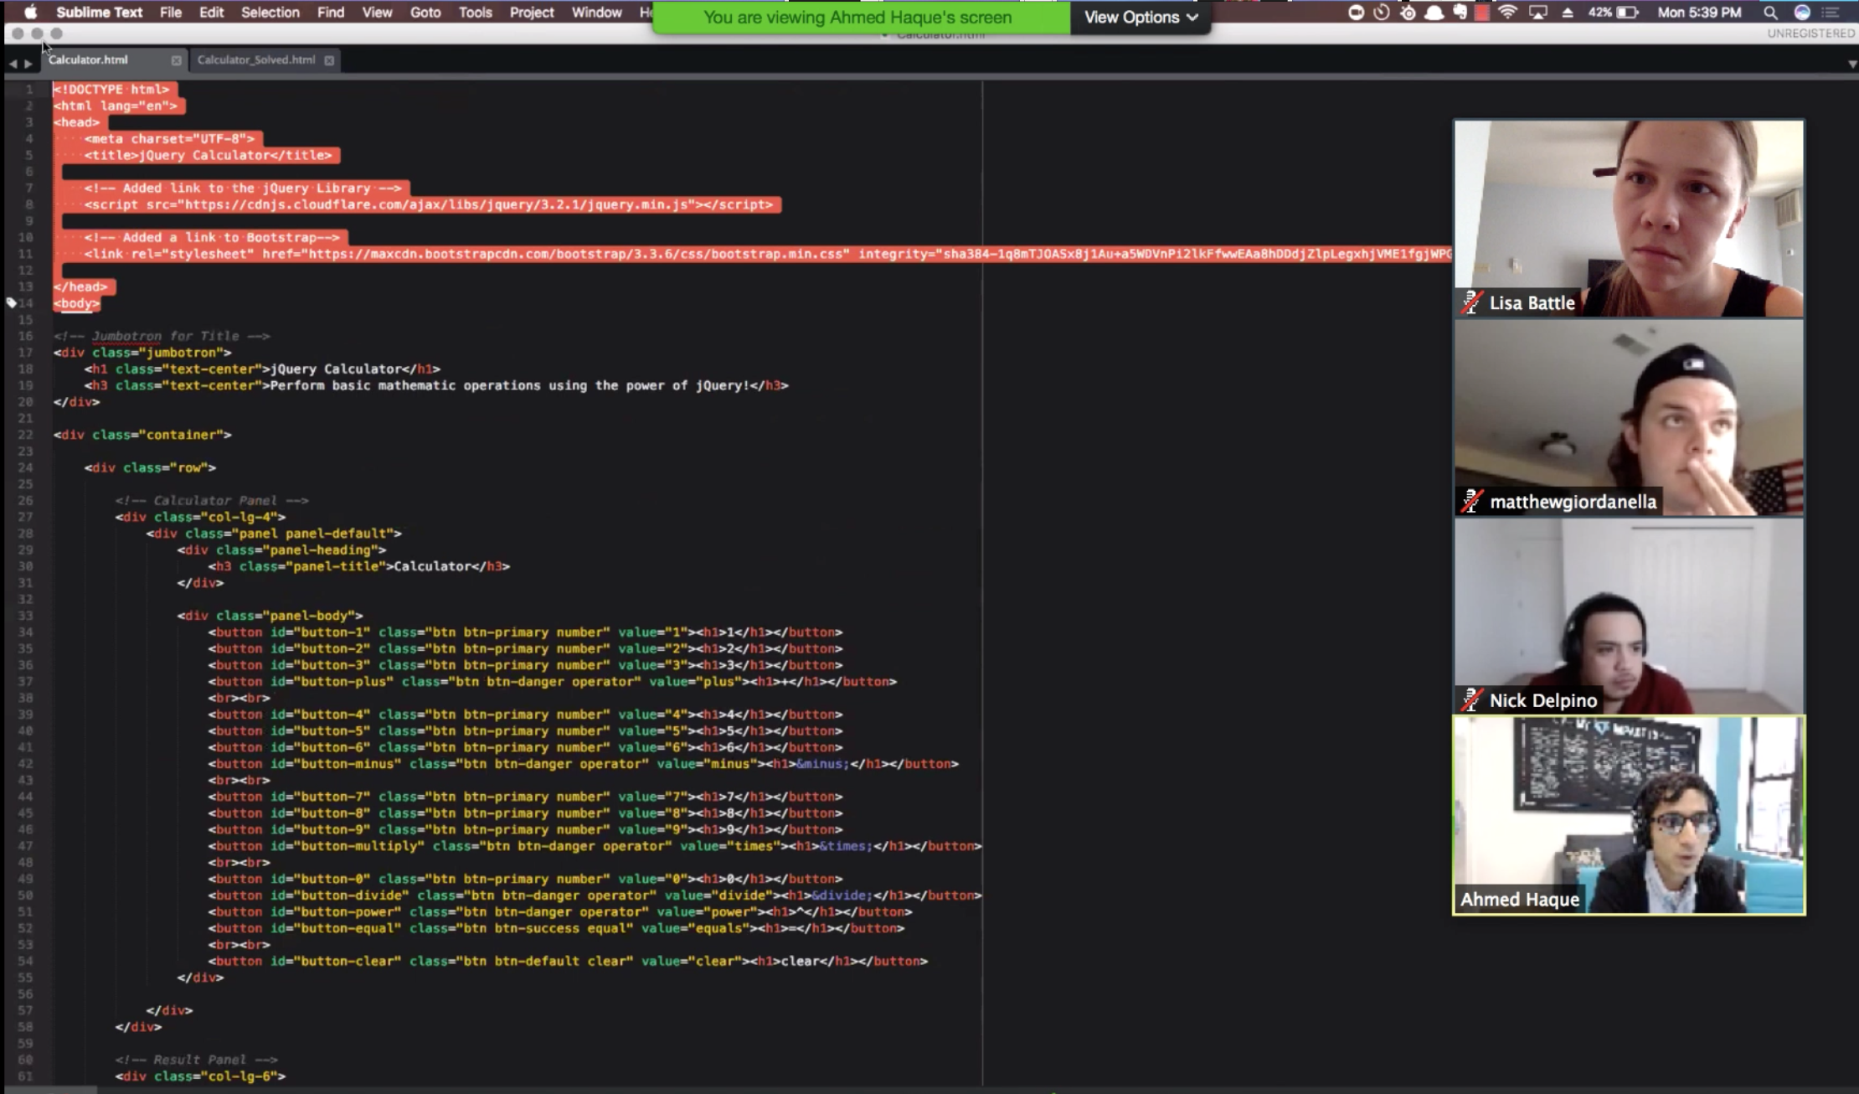
Instructor shares screen during lecture

Slide 44
Instructor shares screen during lecture
Move the Participants tab to your other monitor to avoid covering the shared screen!

Slide 45
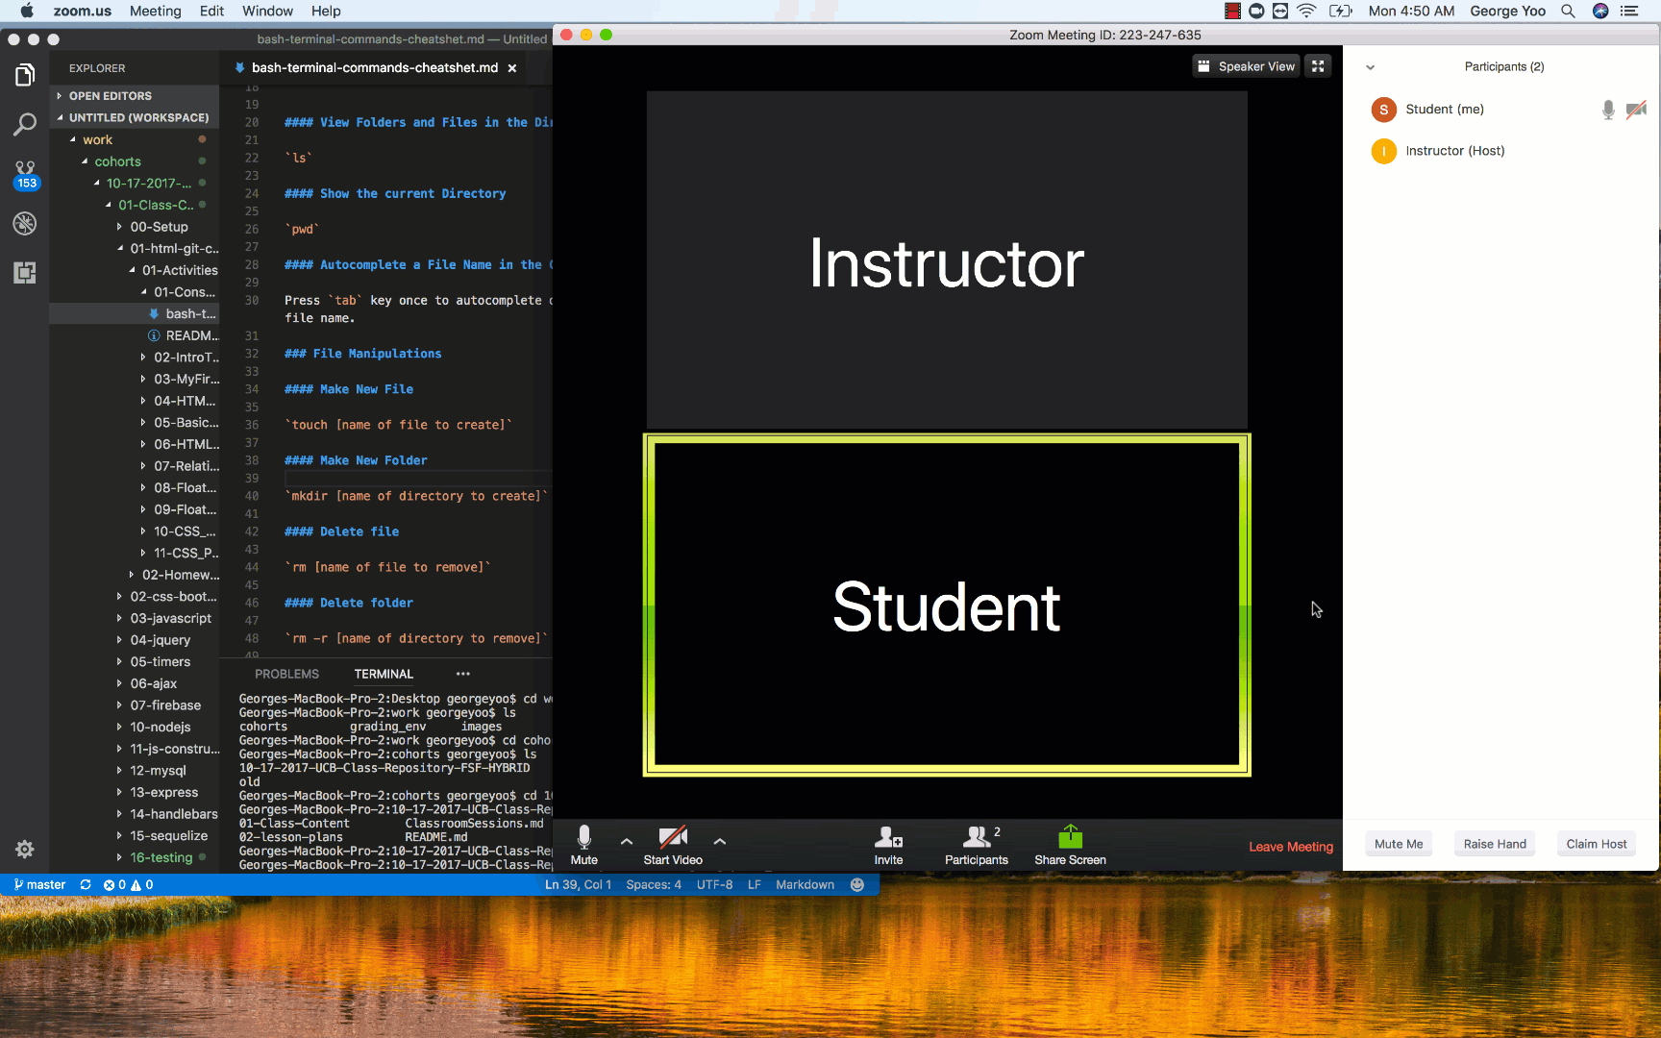
Students can share while asking / answering questions

Slide 46
Students can share while asking / answering questions
Try it! Share your screen with the class!

Slide 47
Moving to group zoom room for activities
For group activities, you will receive a prompt to move into your breakout room.

Slide 48
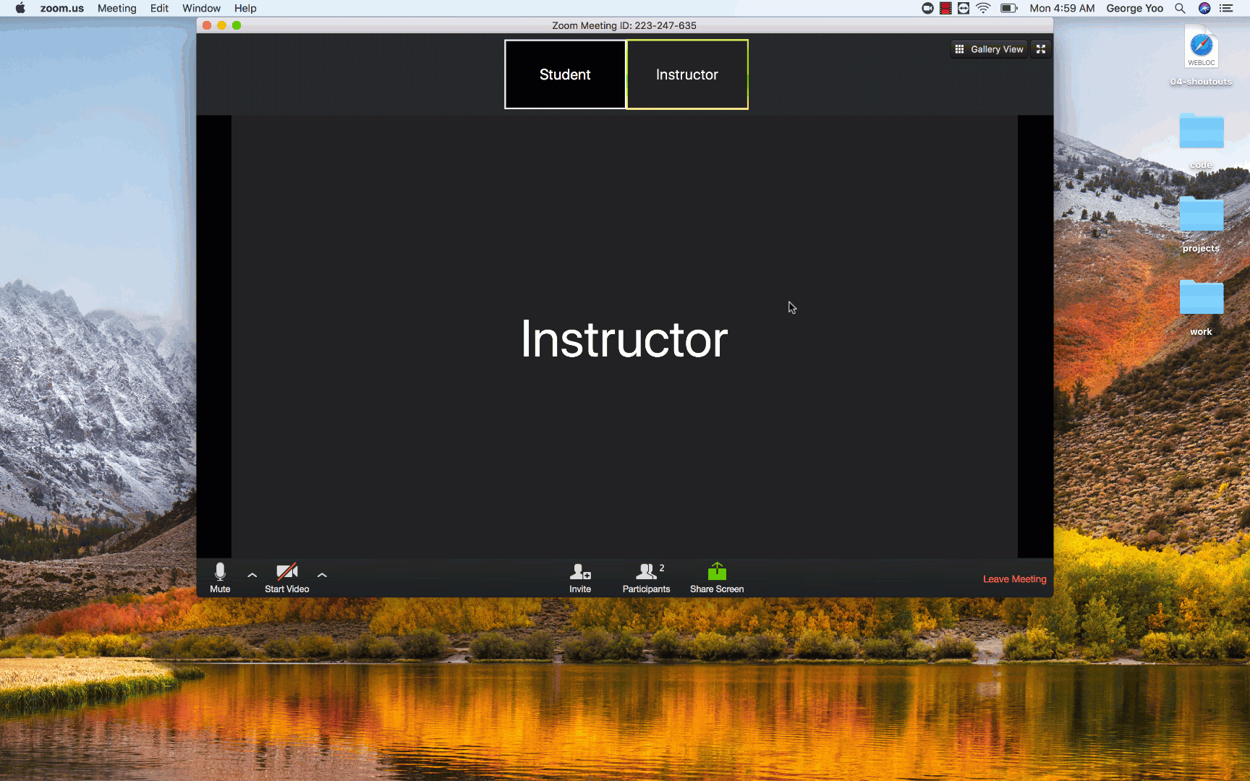
Moving to group zoom room for activities

Slide 49
Moving to group zoom room for activities
Join your breakout rooms when the prompt shows up!
Say “Hi” to your group mates and I’ll bring everyone back!

Slide 50
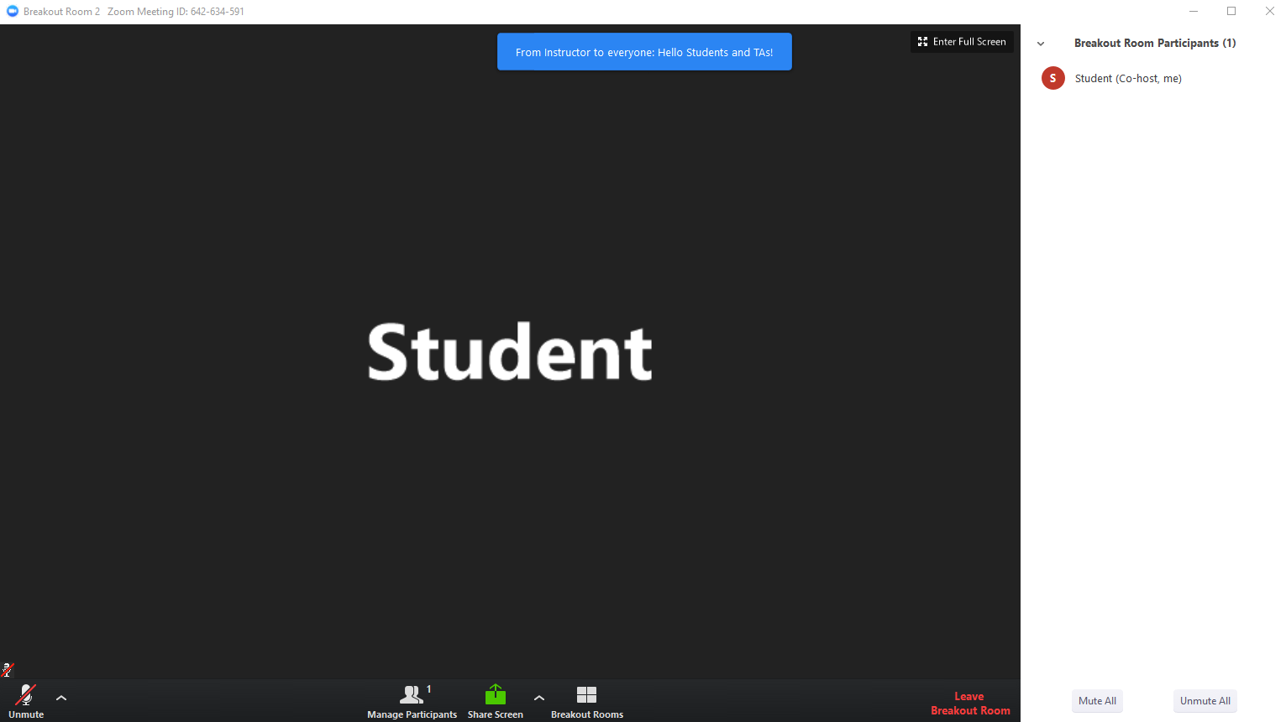
Broadcast Messages
Be on the lookout for Broadcast Messages from the instructor while in breakout rooms!

Slide 51
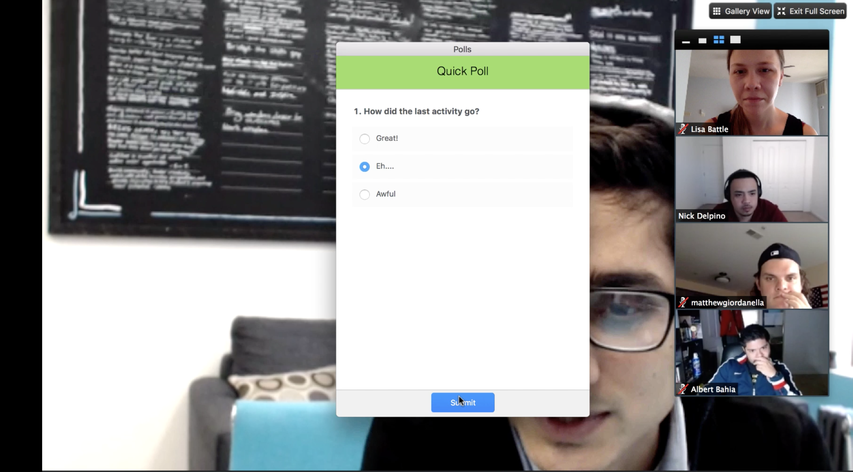
Anonymous Polls: How was that last activity?

Slide 52
Visual Studio Code

Slide 53
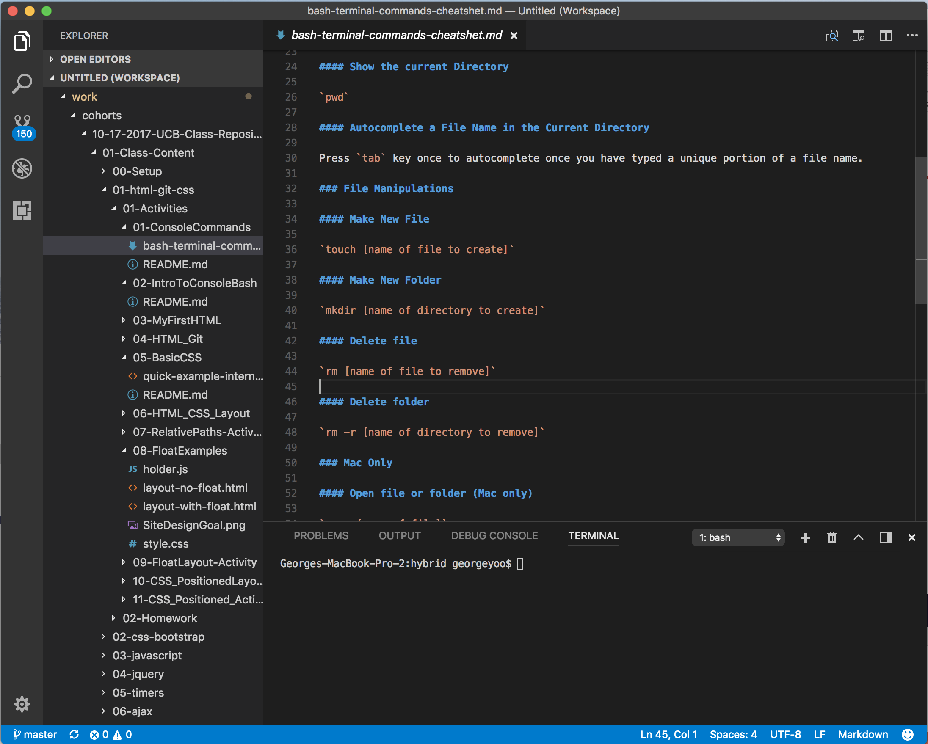
Pre-work should have asked you to install VS Code
Visual Studio Code is an editor for our code
Notes:
Change image to VS Code

Slide 54
VS Code Installation Check
Notes:
Take a few minutes downloading and installing Visual Studio Code!

Slide 55
Get Your Screens Right...

Slide 56
Get Your Screens Right...
Before every class:
Open Slack
Open Zoom Main Room
Open Bootcampspot, mark attendance
Open VS Code, get ready to learn!

Slide 57
Get Your Screens Right...
Screen 1 (Projector):
Zoom
Screen 2 (Workspace):
Slack
VS Code
Bootcampspot

Slide 58
Break Time!

Slide 59
Let’s Get into the Pre-work!

Slide 60
Questions?

